Slide 1

SWOT Analysis
S
W
O
T

Slide 2
Strengths
Opportunities
S
Unique value proposition
Strong Brand Identity and reputation
Loyal affluent user base customer service
O
Service and Market expansion
Data driven personalization
Partnerships and international expansion
Weaknesses
Threats
W
T
Limited User Base
Higher dependence on rewards
Profitability Challenges
Intense competition
Regulatory risks
User Fatigue

Slide 3

Strengths
1. Unique Value Proposition
What it is: CRED rewards users for paying their credit card bills on time, turning a routine financial task into a rewarding experience.
Why it works:
Gamification: The app makes payments feel fun and rewarding by offering “CRED coins” which users can redeem for discounts, products, or even contest entries.
User psychology: This taps into behavioral economics — rewarding good financial behavior helps drive consistent usage and habit formation.
Tech infrastructure: Behind the scenes, the app relies on secure API integrations with banks and credit bureaus to fetch credit data and payments in real-time.

Slide 4
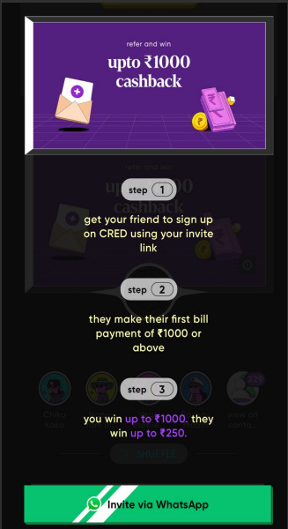

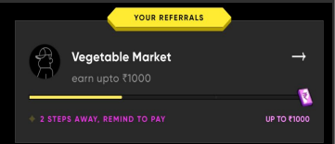
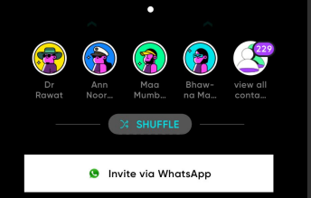

Slide 5

2. Strong Brand Identity & Reputation
What it is: CRED has built a distinct, premium-feel brand that appeals to an urban, digitally savvy audience — especially millennials and Gen Z with high creditworthiness.
Why it stands out:
Marketing excellence: Campaigns like "Not Everyone Gets It" and the viral Rahul Dravid “Indiranagar ka Gunda” ad created massive buzz. Their humor and surprise factor make CRED memorable. : CRED’s ads feature unexpected celebrity pairings in offbeat situations — this positions the brand as culturally sharp and socially relevant
Targeting a High-Quality User Base: CRED's strength lies in its focus on users with excellent credit scores, building a premium user base. This selective approach cultivates a financially responsible community, appealing to advertisers. As of late 2024, CRED boasts a user base with an average credit score of 750+, indicating financial stability. This attracts businesses seeking high-value customers, fueling CRED's revenue streams.

Slide 6



A picture is worth a thousand words

Slide 7
3. Customer Experience
What it is: CRED focuses on making every interaction feel intuitive, smooth, and rewarding.
Strengths here:
Slick interface: The app feels fast, clean, and polished. Users often compare it favorably to other fintech apps which can feel clunky or ad-ridden.
No ads, no clutter: The experience is intentionally frictionless. Instead of aggressive upselling, CRED nudges users with soft cues and thoughtful design.
Support for multiple credit cards: It consolidates all credit card payments in one place, with smart reminders, auto-payment options, and payment history — simplifying life for users who juggle cards.

Slide 8
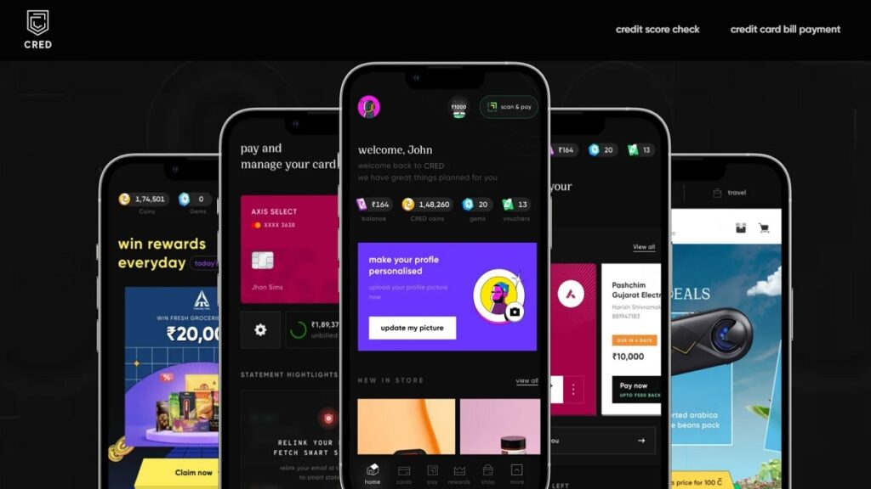

Slide 9
4. Technology & Data Infrastructure
What it is: CRED leverages data to deliver personalized offers, detect patterns, and enable financial products like CRED Mint (P2P lending) or CRED Cash (instant credit lines).
Strengths here:
Real-time credit scoring and payment sync: CRED securely connects to banks and credit bureaus to keep tabs on payments and credit health.
Data insights: With such a high-quality user base, CRED has a goldmine of credit and spending behavior data — which it can use for product innovation and monetization.
Security architecture: The company emphasizes privacy and uses strong encryption and compliance practices — a key trust-builder when handling financial data.

Slide 10
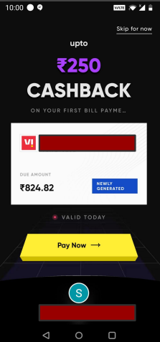
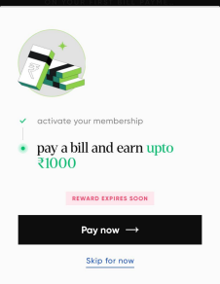

Slide 11

Weakness
1. Limited User Base
Where the challenge lies: CRED’s model is built around users with high credit scores and credit cards — a small slice of India’s population.
Only ~35 million active credit card users exist in India, compared to 300+ million UPI users. So CRED is operating in a much narrower market. This niche approach means CRED misses out on the larger market of individuals with lower credit scores or no credit history. For instance, in 2024, only about 20% of the Indian population had a credit score above 750, CRED's target. This limits its expansion possibilities.
By design, it excludes those with lower credit scores or no access to formal credit, limiting both scale and inclusivity.
This makes it hard for CRED to grow as fast or as widely as apps like PhonePe or Paytm, which serve everyone with a bank account.

Slide 12

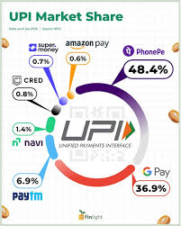

Slide 13
2. High Dependence on Rewards
Where the challenge lies: CRED’s engagement engine is built around perceived value — people come back for the rewards.
If the rewards become less attractive, delayed, or repetitive, users lose interest. That’s already a complaint seen in app reviews.
This creates a fragile loyalty loop — users may not be loyal to the platform itself, just to the benefits.
If costs force CRED to cut back on offers or limit redemptions, it risks user churn.

Slide 14
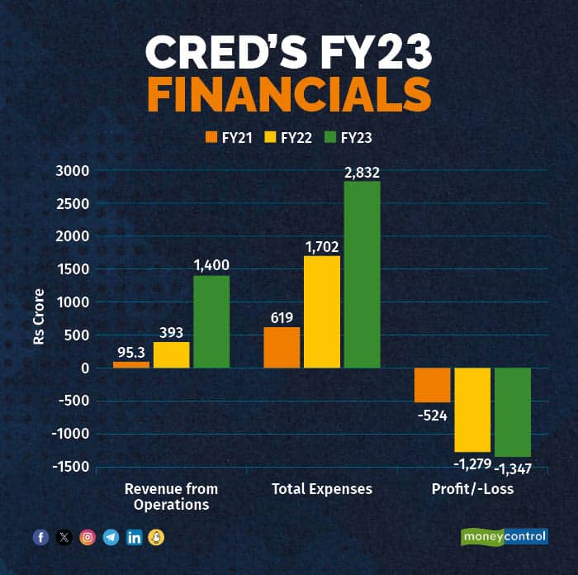
3. Profitability Challenges
Where the challenge lies: CRED has massive brand presence and funding, but it’s still bleeding money.
It spends heavily on marketing, cashback, partnerships, and tech to attract and retain users.
Despite revenues crossing ₹2,400 crore (FY24), losses remain high, with no clear timeline for turning profitable.
This creates pressure from investors and raises sustainability questions, especially in a market where users are price-sensitive and alternatives are free.

Slide 15
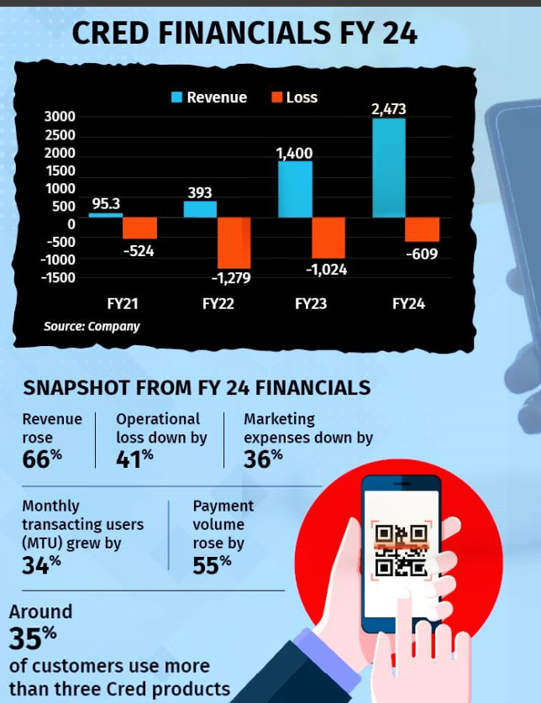

Slide 16

Opportunities
1.Service & Market Expansion
How it fits the fintech landscape: CRED can break out of its credit-card-only bubble and become a broader personal finance platform.
Expanding into personal loans, BNPL (Buy Now Pay Later), and insurance would allow CRED to serve more everyday financial needs, not just payments.
As users mature financially, they look for a one-stop app for spending, saving, and investing — CRED has the brand and infrastructure to become that.

Slide 17
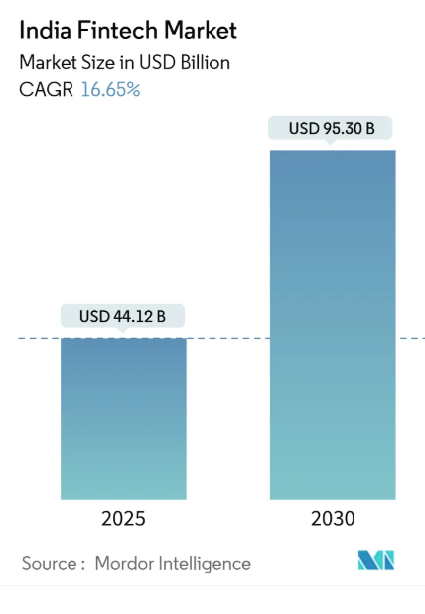
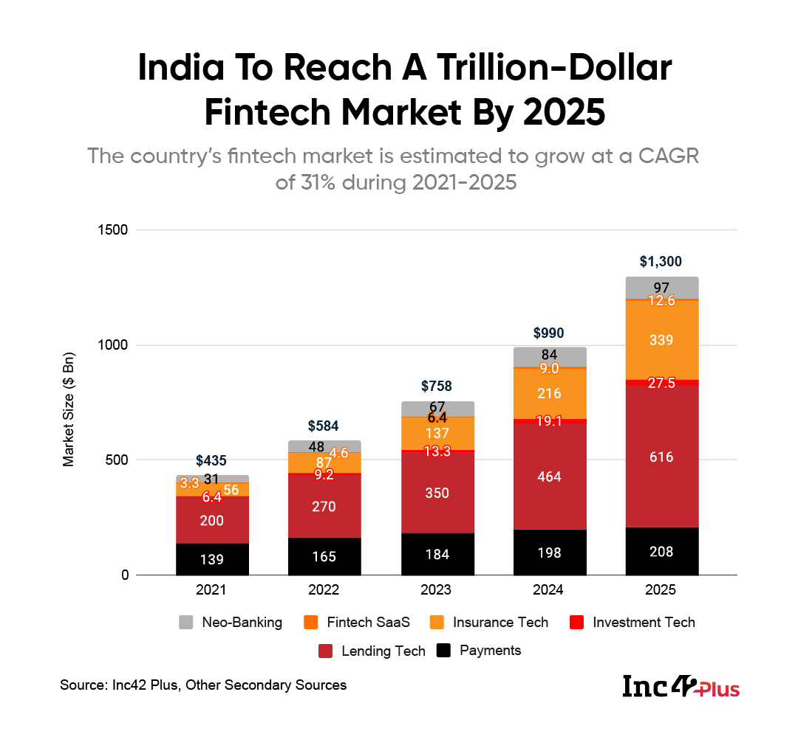

Slide 18

2. Data-Driven Personalization
Why it’s a huge opportunity in fintech: CRED has access to high-quality credit, spending, and behavioral data — and that’s gold in personal finance.
By applying AI/ML models, CRED can offer smarter product recommendations, interest rates, spending insights, and alerts.
For example, it could suggest investment products based on spending patterns, or pre-approve credit based on real-time usage trends.
This not only improves customer experience and loyalty, but also reduces risk and improves margins for lending products.

Slide 19
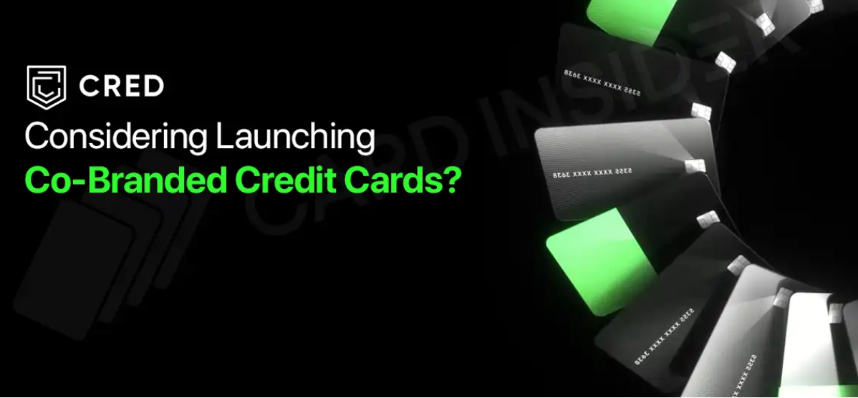

Slide 20
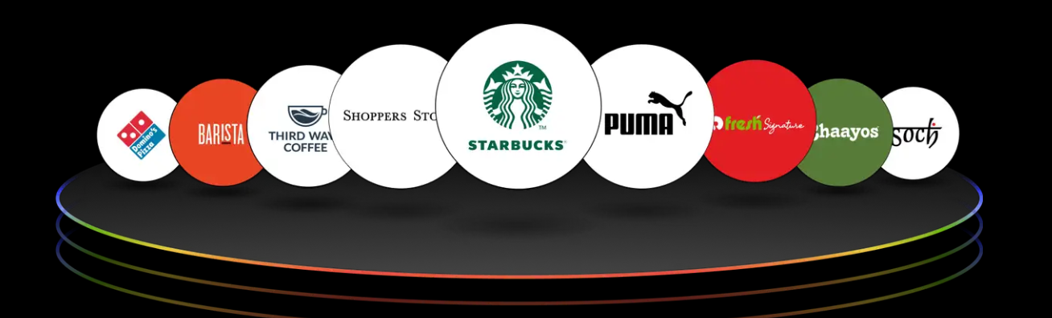
3. Partnerships & International Expansion
Where growth could come from next:
CRED can partner with e-commerce platforms, lifestyle brands, and travel services to build a premium rewards and payments ecosystem.
With India’s fintech market getting crowded, expanding into Southeast Asia, the Middle East, or NRI markets could open up similar affluent segments.
Strategic partnerships could also involve wealthtech, insurtech, or neobanks — creating a network effect across financial services.

Slide 21

Threats
1. Intense Competition
CRED operates in a saturated market, competing with well-funded fin-techs, digital wallets, and traditional banks. As these players roll out similar rewards, credit, and investment products, CRED risks losing its edge.
2. Regulatory Uncertainty
As CRED expands into lending, UPI, and wealth products, it becomes more exposed to RBI and SEBI regulations. Any tightening of rules around digital credit, data privacy, or user eligibility could disrupt its growth plans.
3. Engagement Fatigue
CRED’s heavy reliance on gamified rewards and exclusivity may wear thin over time. In a utility-driven market like India, users may shift toward apps offering simpler, more practical financial solutions.

Slide 22
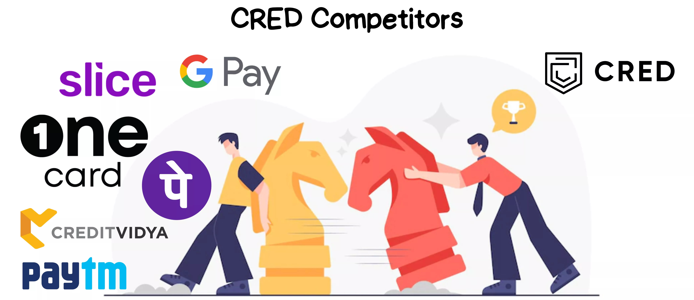

Slide 23
Threats
4. Changes in Credit Card Market Dynamics
Changes in the credit card market pose a threat to CRED. Market saturation and the rise of BNPL services could reduce CRED's transaction volume. BNPL is projected to reach $850 billion by 2025. This shift challenges CRED's reliance on credit card payments. It could decrease revenue.
5. Economic downturns can significantly impact CRED’s business model, which depends heavily on discretionary spending and timely credit card repayments. In times of financial stress—like job losses or inflation spikes—users may cut back on spending, miss payment deadlines, or avoid credit altogether. This reduces transaction volume on the platform and weakens the effectiveness of reward-based engagement. If defaults rise or credit usage falls, it could directly hit CRED’s revenue streams from lending, offers, and partnerships tied to user activity.

Slide 24
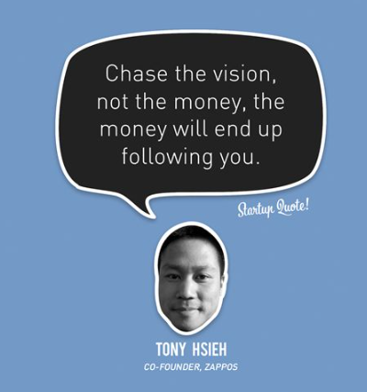


Slide 25
The End of the Beginning

